Slide 1
TBD

Slide 2







Related Search Logos

Slide 3


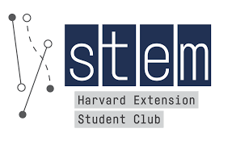


Nontraditional Harvard Logos

Slide 4
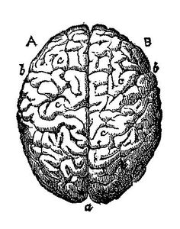
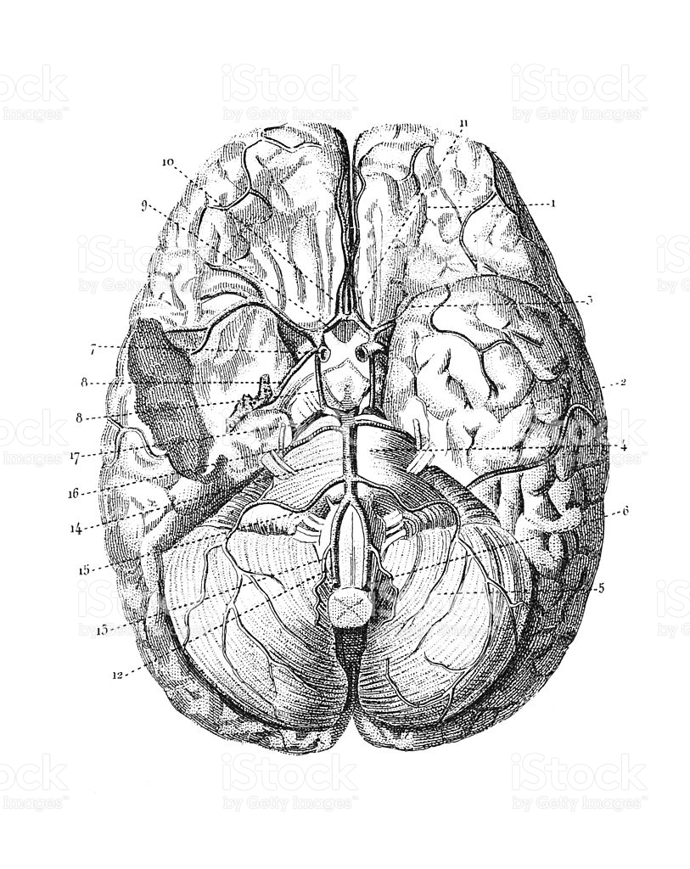
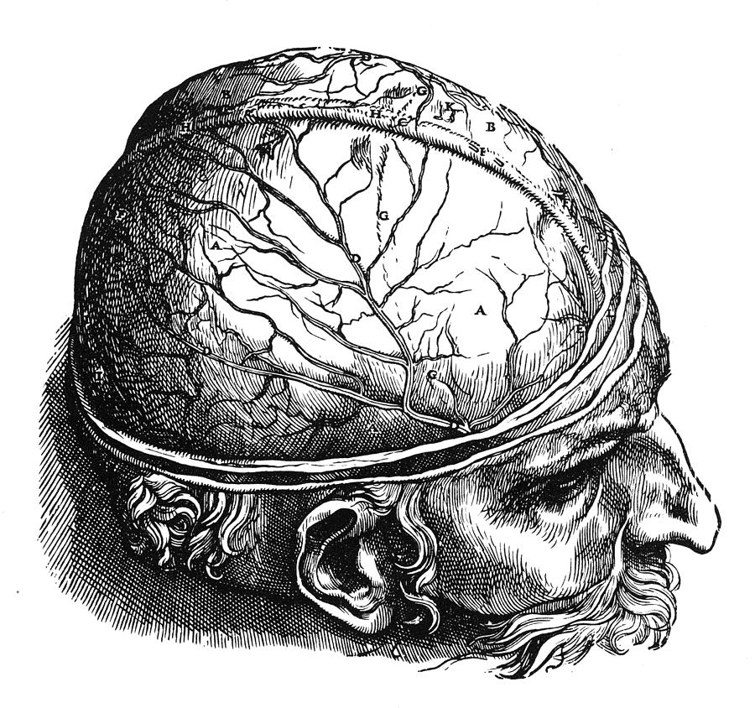
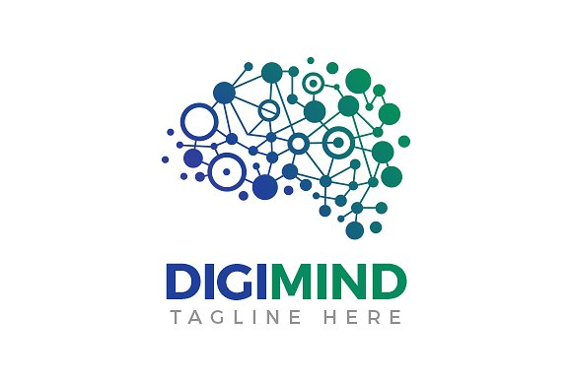
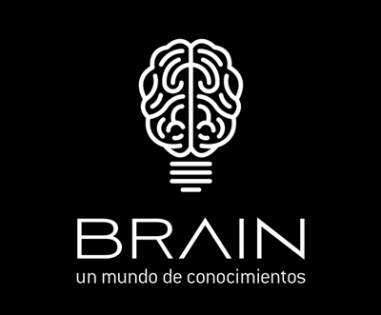
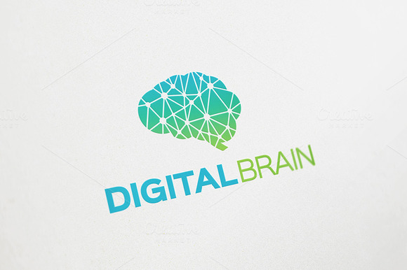
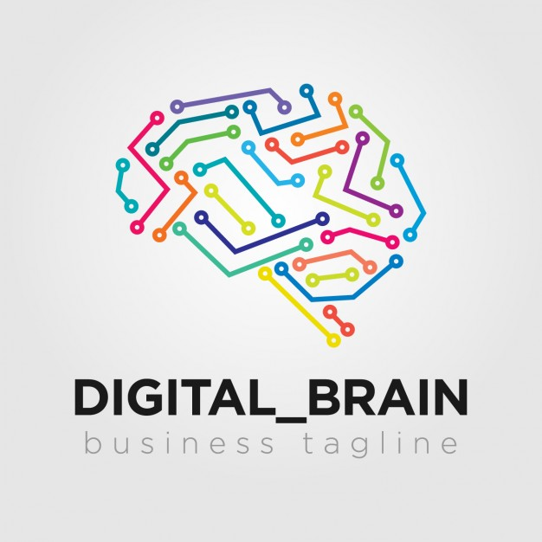
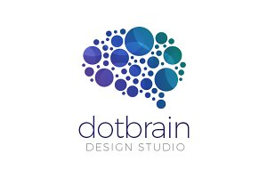
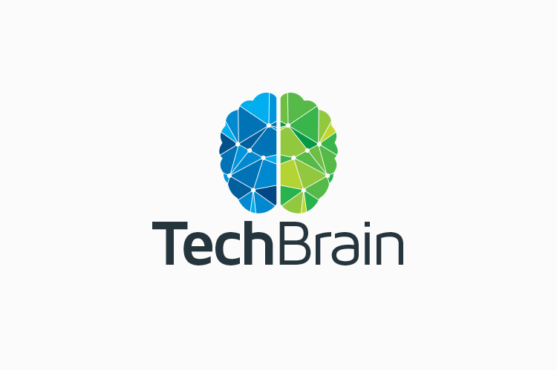
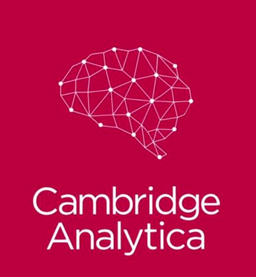
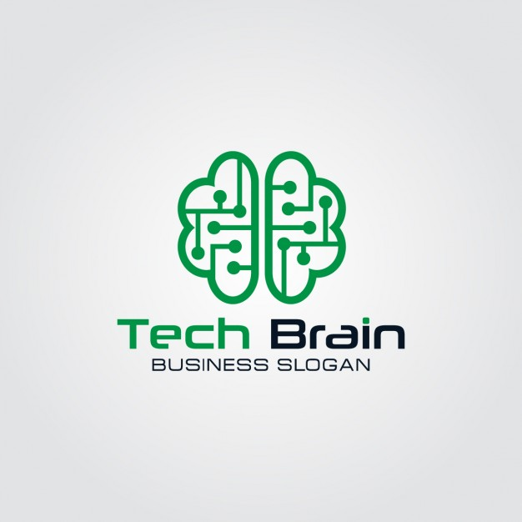
Logo Inspiration: Brain

Slide 5




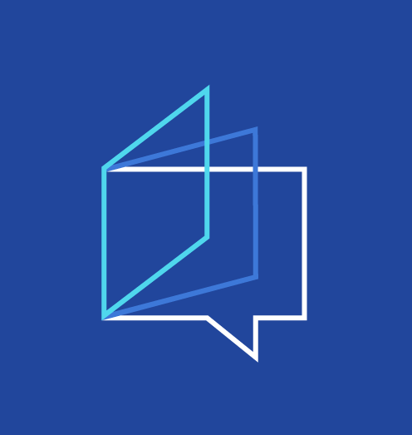



Logo Inspiration: Books

Slide 6
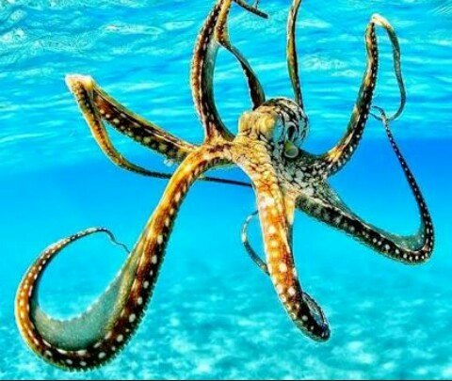


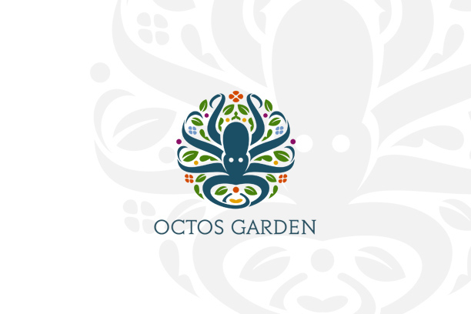
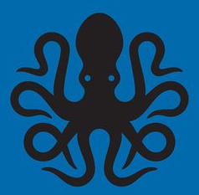
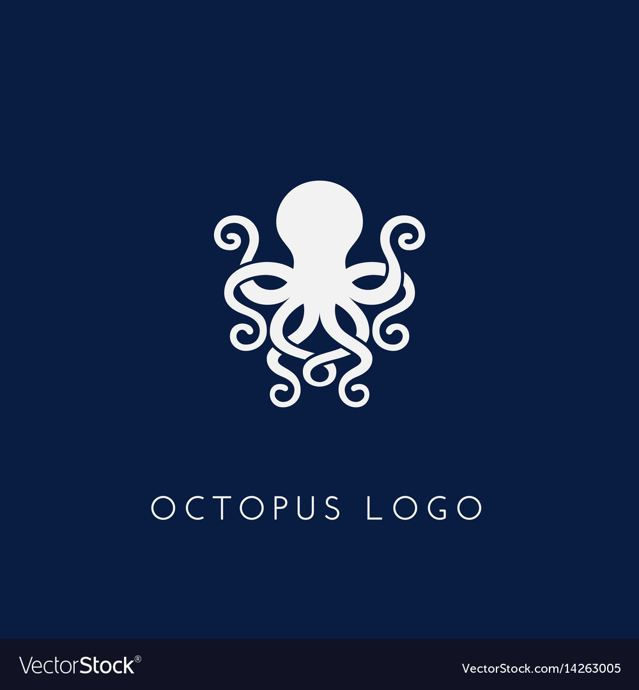
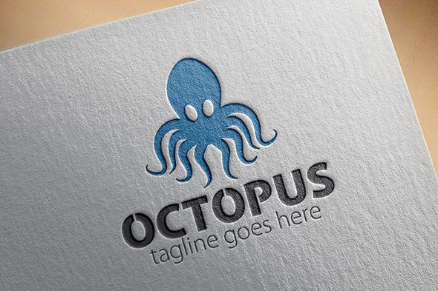

Logo Inspiration: Octopus

Slide 7
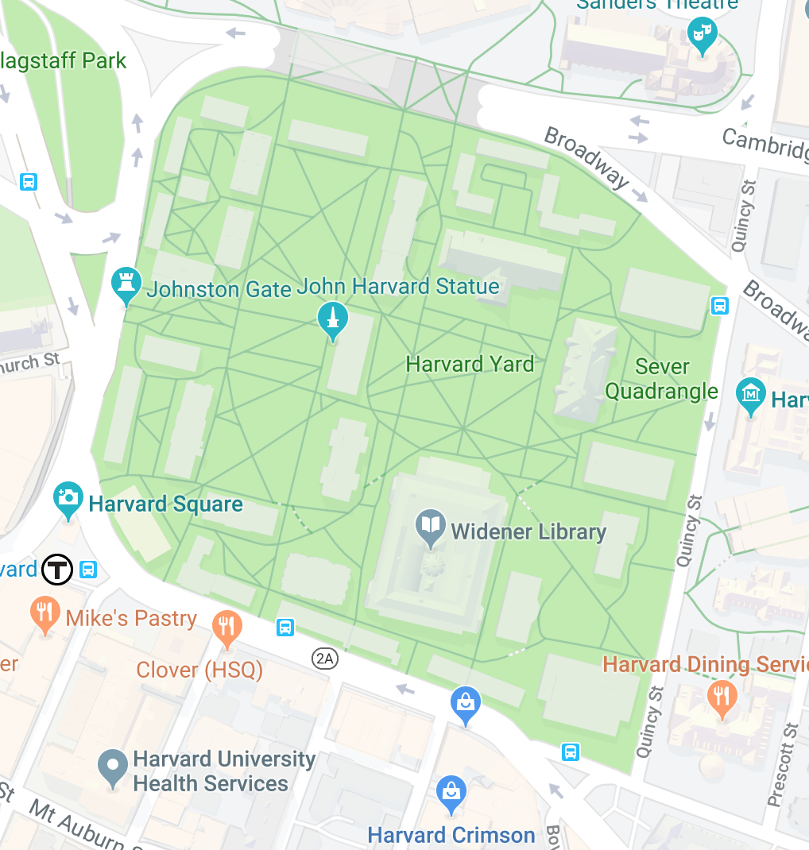
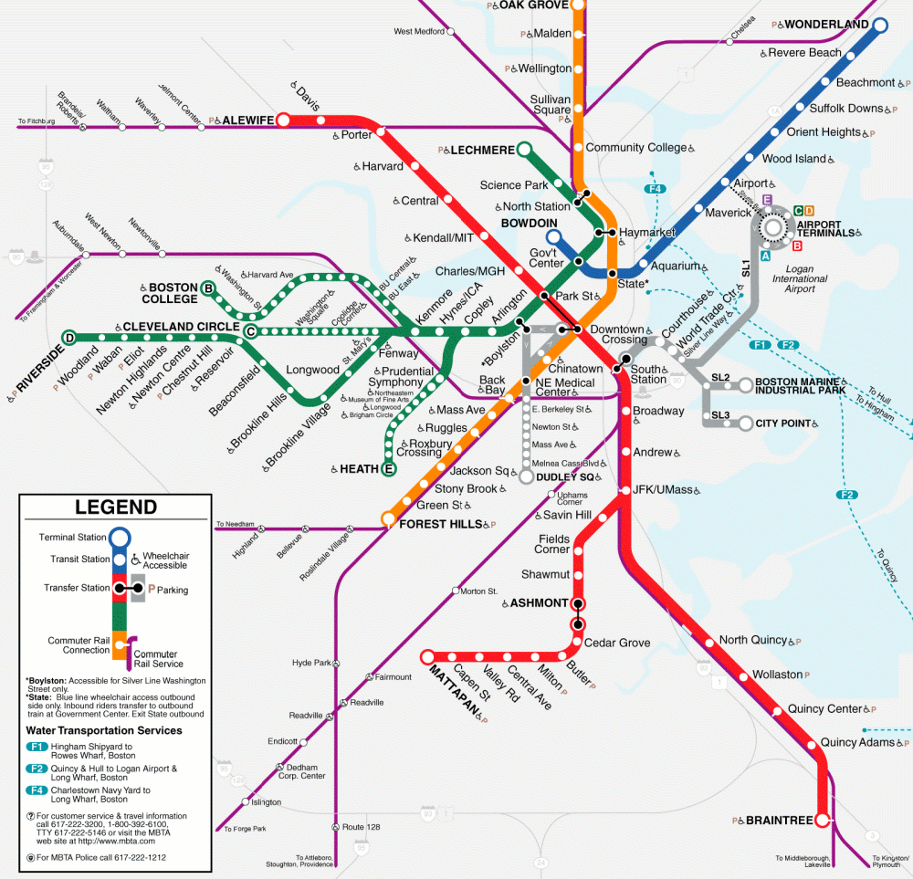
Concept 1: brain + harvard yard
Search engine for large digital database of books. Searching for concepts, not keywords. Extensive user base and diverse content.
Concept - Brain = intellectual capacity. Functions as the coordinating center of intellectual activity. Draws connections and brings multiple senses and experiences into one central location.
Design Idea - Form a brain out of geometric circuit lines/connectors. Lines form the T lines or Harvard Yard paths.
HARVARD YARD
+
+
OR
T MAP
BRAIN
CIRCUIT

Slide 8
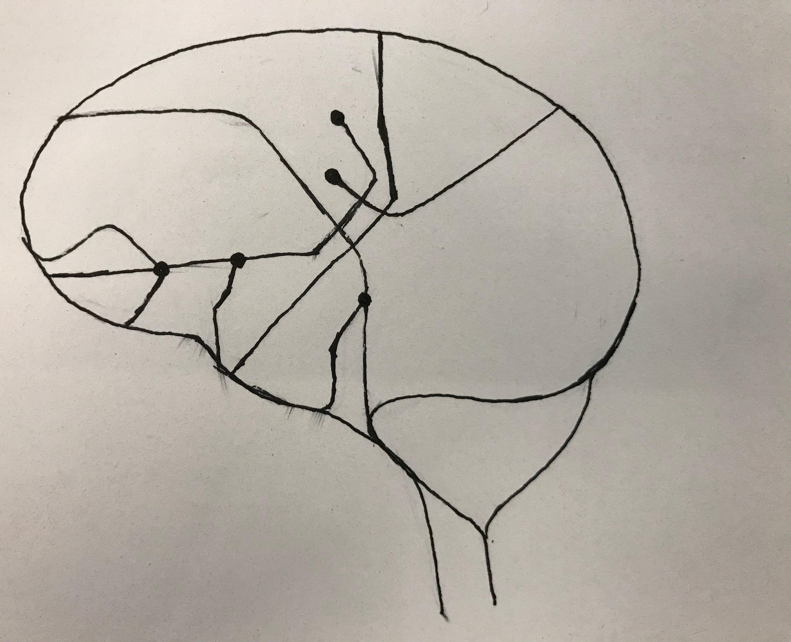
Concept 1: brain + harvard yard

Slide 9
Concept 2: brain + Octopus
Search engine for large digital database of books. Searching for concepts, not keywords. Extensive user base and diverse content.
Concept - Octopus head is central nervous system - tentacles reaching out into multiple books and databases of text. “The brain of an octopus works like an internet of brains! Their main CPU is only the size of a walnut, but each of their 8 arms carry packets of neurons too. This network of brains enable an octopus to approach the power of one central brain. Researchers think each of the collections of neurons in the arms can carry out instructions independently and think for themselves”
Design Idea - Octopus head is the center of the brain with the tentacles reaching up to form a brain outline, tentacles become the connectors. Arms of octopus could be holding books.
+
BRAIN
OCTOPUS

Slide 10
Search Name
Abstract
Digest
Pith
Gist
Epitome
Fundamental
Principle
Conspectus
Concept
Idea
Dissect
Decode
Deconstruct
Unbind/bound
Unravel
Query
Search
Library
Collection
Corpus
Bookmark
Earmark
Save
Marker
Placeholder
Book
Codex
Tome
Folio
Volume
Opus
Omnibus
Compendium
Database
Name Ideas:
Decodex
Books Unbound

